Slide 1
Advanced Software Engineering Course
Antonio Di Monaco
Computer Science Bachelor Program

Slide 2
Who we are

Slide 3
Why Advanced Software Engineering?
Do I need this?
No, not really :) ... but
You’ll learn how to code better
... that means, how to design better
... that means, how to understand better

Slide 4
What you will find here
Theory
Lessons:
Monday, 15.00 => 16.30
Wednesday, 15.00 => 16.30
Thursday, 8.00 => 9.30
Exercises (live)
Personal opinions
Experienced advises

Slide 5
We use Java
No need of a specific version, Java 25 LTS is enough (even lower are fine)
We’ll also use Maven
No need to know any additional Java framework, they won’t be allowed anyway
Some Typescript here and there

Slide 6
Topics!
Today: recap about Interfaces
In-depth Git
Design Patterns: the whole story
Type systems
Generics
Metaprogramming
Reflection

Slide 7
Topics!
Memory management
Functional programming
Unit Testing
Concurrent programming
Async models
Coroutines

Slide 8
Don’t be afraid to speak
Camera
Availability for clarification talks
Communication
&
Rules

Slide 9
AI

Slide 10
Timeline
Evaluation
  How it works
  What is measured
  Grades
Ask me … ALWAYS!
DO NOT overdo
Exam

Slide 11
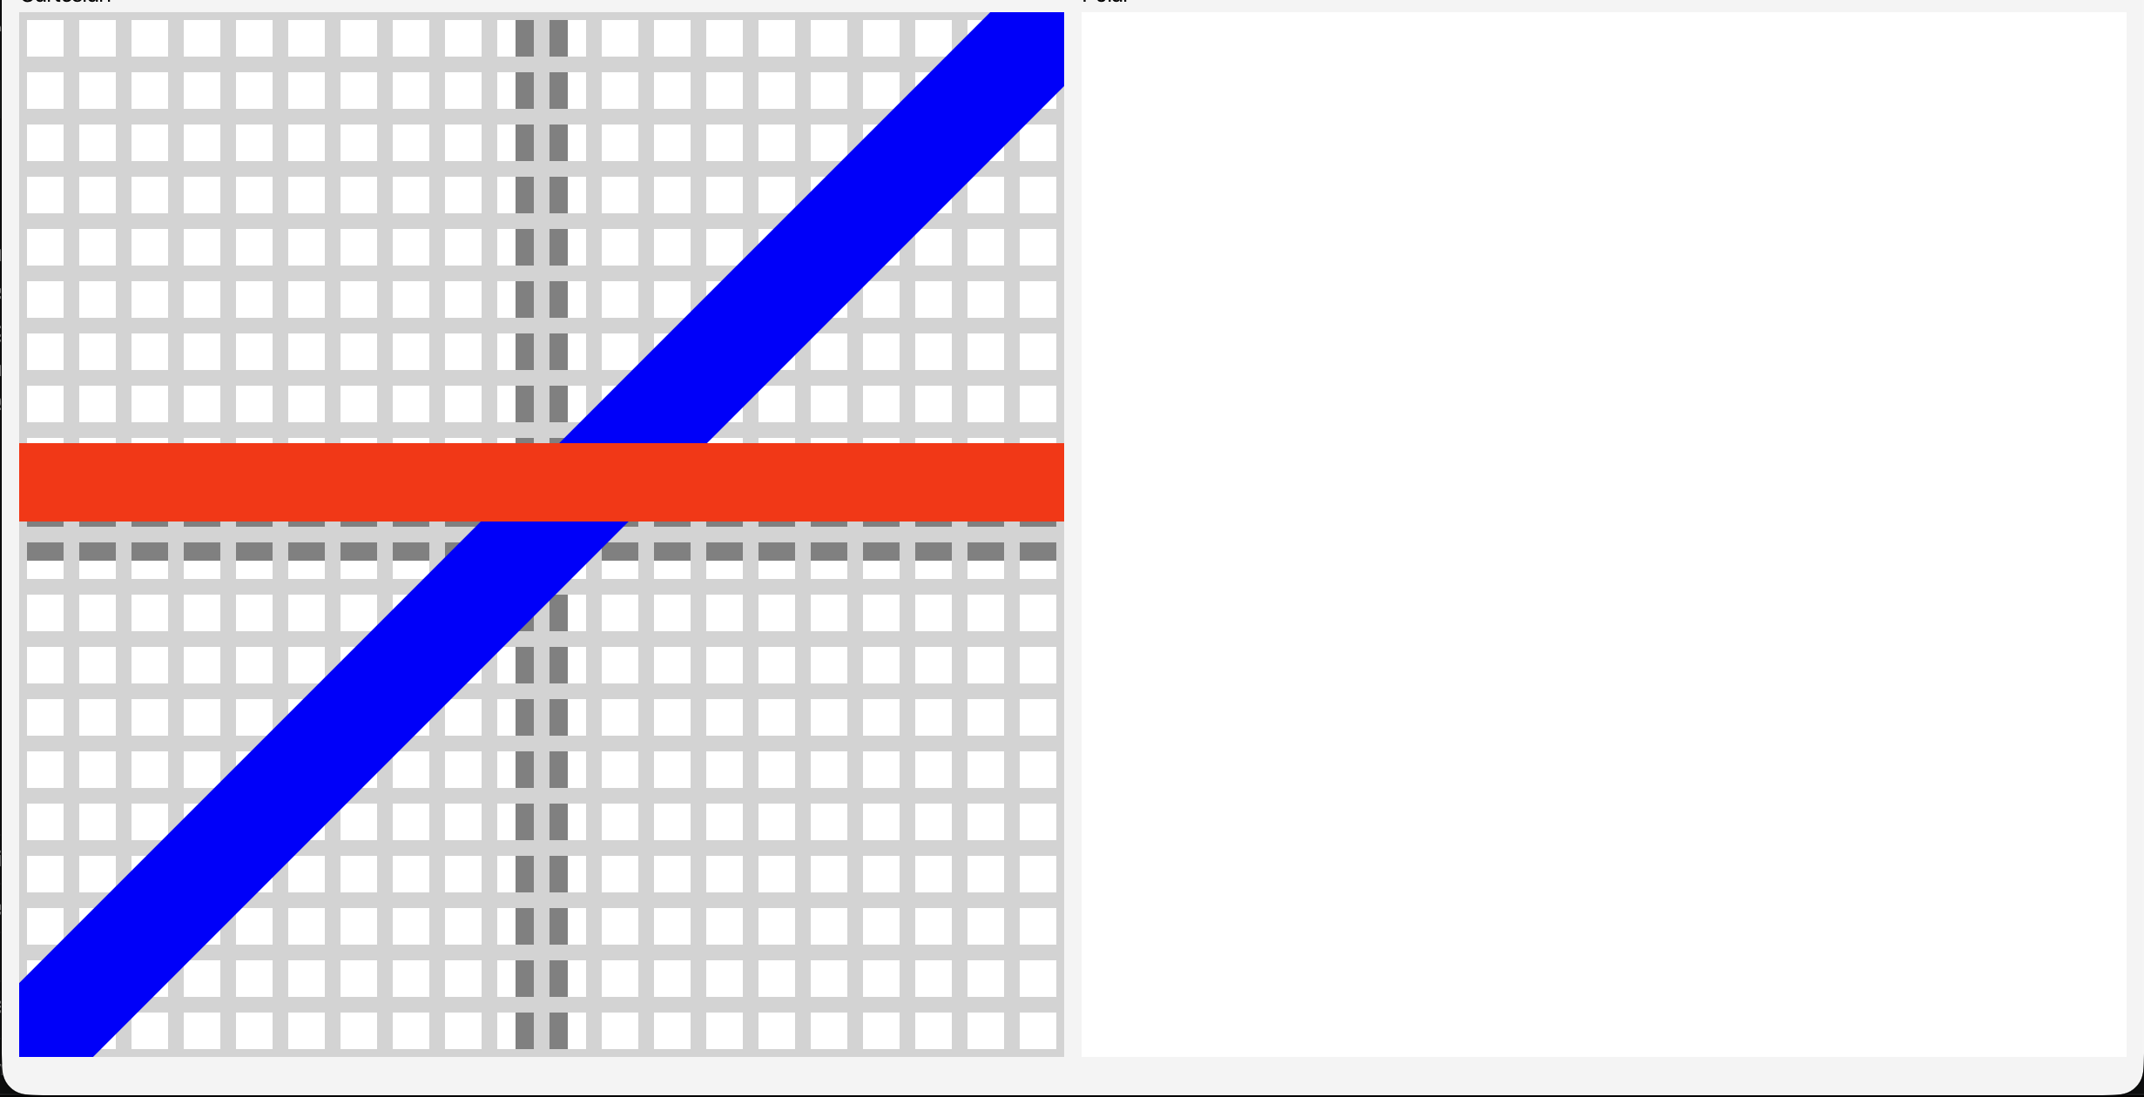
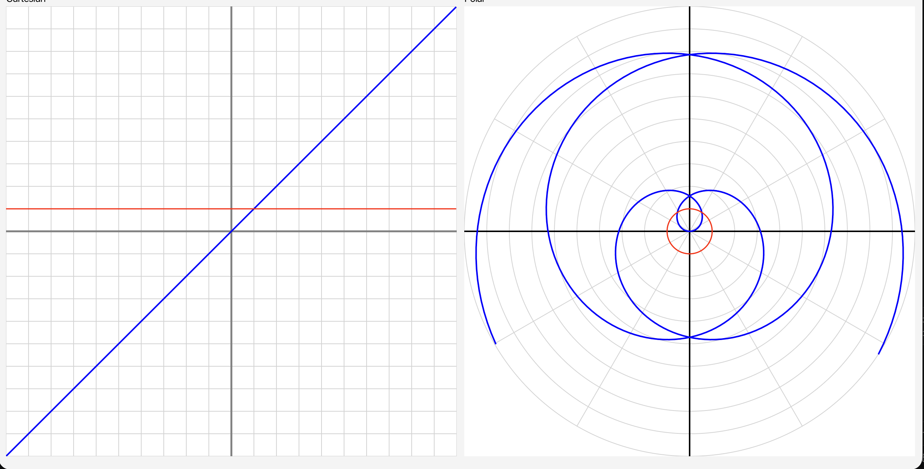
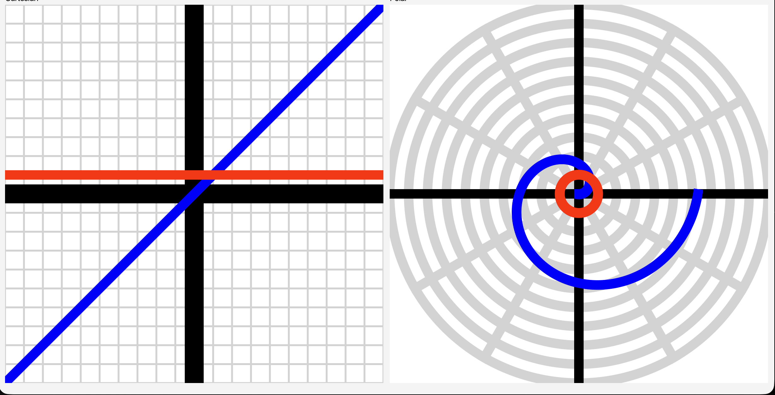
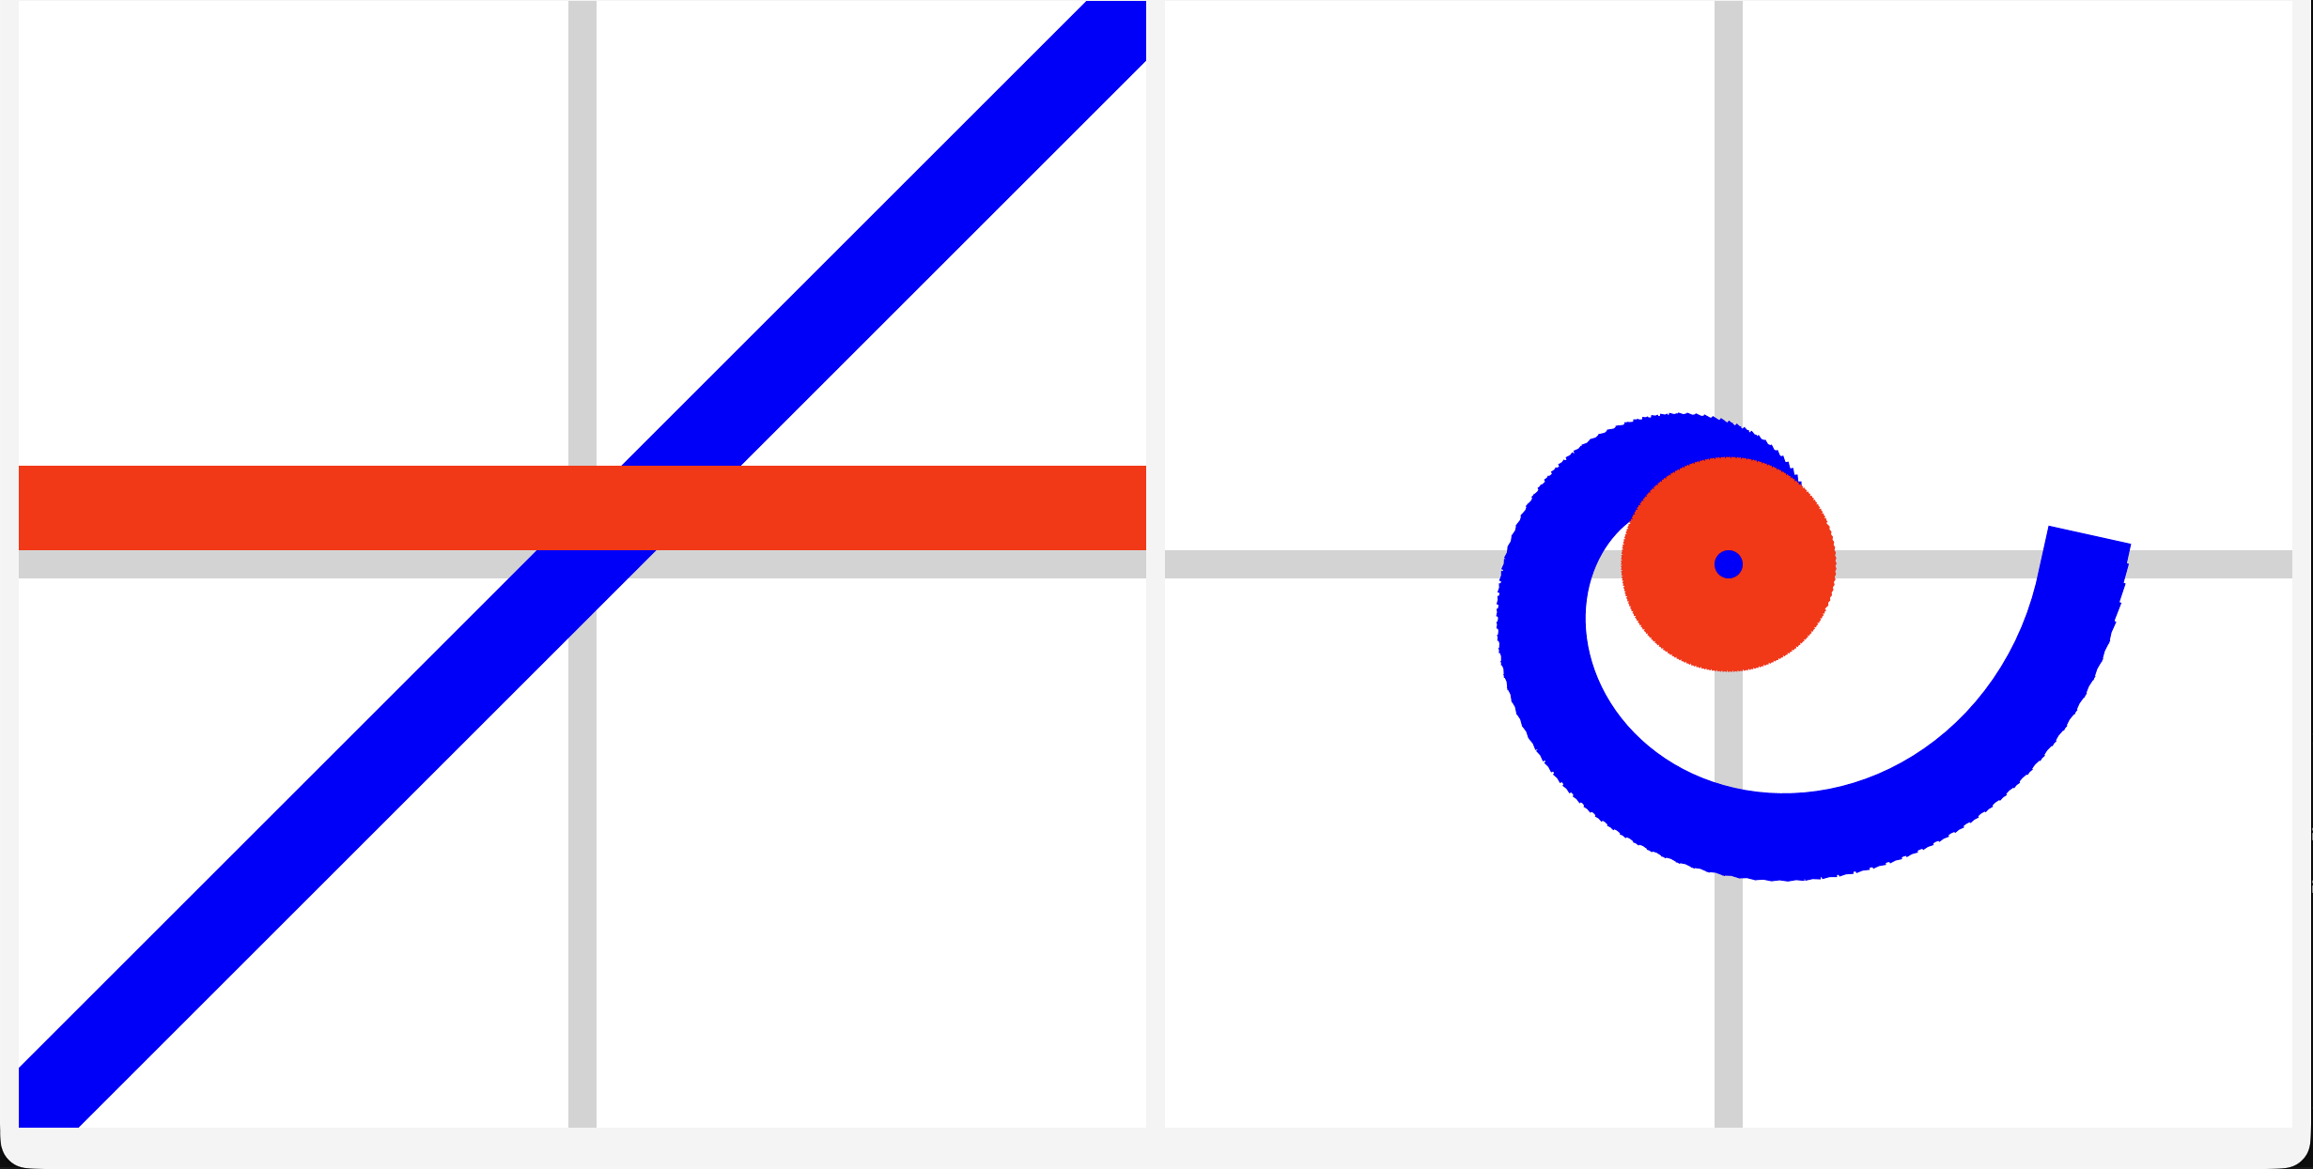
Don’t do this

